Slide 1
FY 23-24 Third Quarter Financial Report For the Period Ending 3-31-2024
BOE MAY 14, 2024
Notes:
Good afternoon President Pannunzio, Superintendent Macaluso and members of the board.
This afternoon we will be walking through the budget process, including the student count data and its use in driving the Fund 10 General Fund (Operating Fund) expenditures.
The document is not complete nor are all modifications in place at this time.
How would you like to proceed? Pose questions after each section or wait until the end?

Slide 2
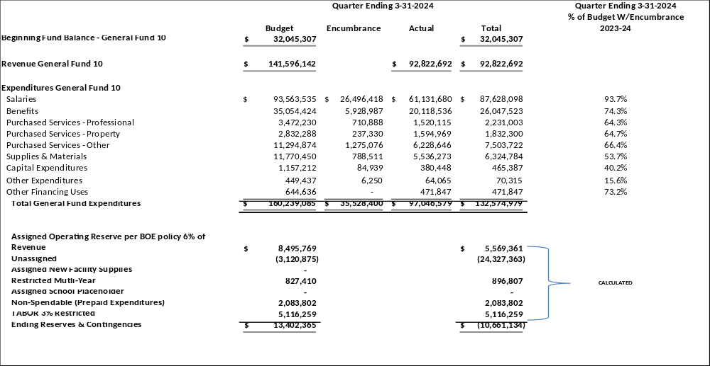



2023-24 SCHOOL YEAR REVENUE AND EXPENDITURE SUMMARY
FOR THE QUARTER ENDING 3-31-2024
PAGE 1

Slide 3
INCREASE (DECREASE) FROM PRIOR YEAR
Salaries
Fringe Benefits
Purchased Services - Professional
Purchased Services - Property
Purchased Services - Other
Supplies - Materials
Capital Outlay
Other Expense
Other Sources & Uses
Total Expenditures
$8,920,601
3,171,037
(132,762)
364,698
1,816,428
(3,299,039)
(11,531)
(30,955)
20,654
$10,819,131

Slide 4
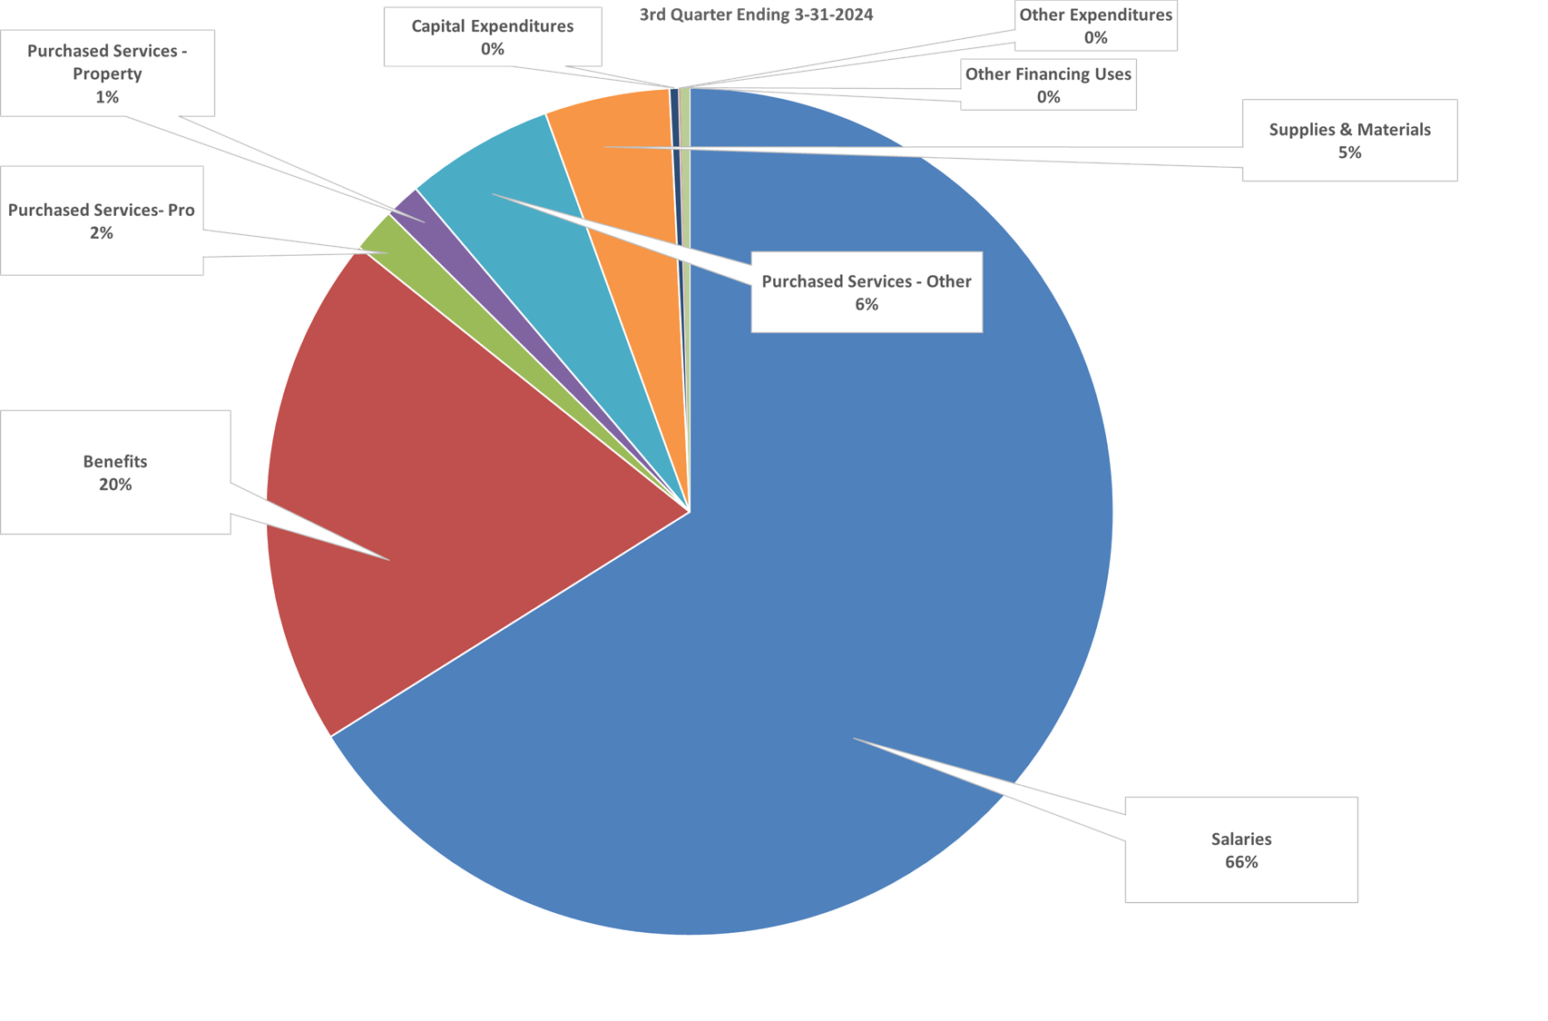
FUND 10 3RD QRT FY 24

Slide 5
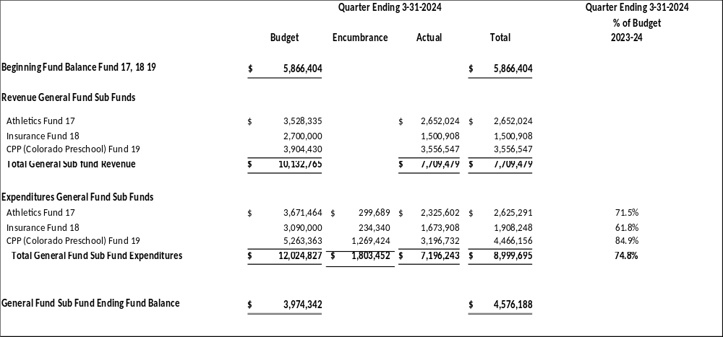
General Fund Sub Funds - Summary

Slide 6









General Fund Sub Funds – By Fund
 | Adopted Budget | Encumbrance | Actual | 3rd Quarter Total
Athletic Fund 17
Beginning fund balance | $ 296,681 | $ - |  | $ 296,681
Revenue | $ 3,528,335 | $ - | $ 2,652,024 | $ 2,652,024
Expenditures | $ 3,671,464 | $ 299,689 | $ 2,325,602 | $ 2,625,291
Revenue over (under) expenditures | $ (143,129) | $ (299,689) | $ 326,422 | $ 26,733
Ending fund balance | $ 153,552 | $ (299,689) | $ 326,422 | $ 323,414
Insurance Fund 18
Beginning fund balance | $ 2,215,919 |  |  | $ 2,215,919
Revenue | $ 2,700,000 | $ - | $ 1,500,908 | $ 1,500,908
Expenditures | $ 3,090,000 | $ 234,340 | $ 1,673,908 | $ 1,908,248
Revenue over (under) expenditures | $ (390,000) | $ (234,340) | $ (173,000) | $ (407,340)
Ending fund balance | $ 1,825,919 | $ (234,340) | $ (173,000) | $ 1,808,579
Preschool Fund 19
Beginning fund balance | $ 3,353,804 |  |  | $ 3,353,804
Revenue | $ 3,904,430 | $ - | $ 3,556,547 | $ 3,556,547
Expenditures | $ 5,263,363 | $ 1,269,424 | $ 3,196,732 | $ 4,466,156
Revenue over (under) expenditures | $ (1,358,933) | $ (1,269,424) | $ 359,815 | $ (909,609)
Ending fund balance | $ 1,994,871 | $ (1,269,424) | $ 359,815 | $ 2,444,195
General Fund Sub Fund Ending Fund Balance | $ 3,974,342 | $ (1,803,452) | $ 513,236 | $ 4,576,188
NOTE:
FUND 17 Athletics Fund expenditures did not increase as projected
FUND 18 Insurance Fund nothing of note
FUND 19 Universal Preschool revenue is a surprise. District just filed for the 4 year old “true-up” by UPK. May or may not receive additional revenue.
Remaining “old revenue” from CDE is $3,353,804-$4,466,156 = ($1,112,352)

Slide 7
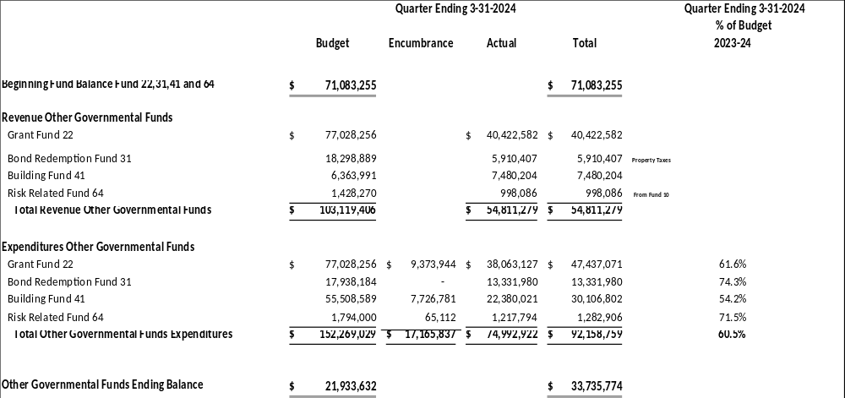
Other Governmental Funds - Summary

Slide 8
Other Governmental Funds – Funds 22 and 31
Other Governmental Funds | Adopted Budget | Encumbrance | Actual | 3rd Quarter Total
Grant Fund 22
Beginning fund balance | $ - |  |  | $ -
Revenue | $ 77,028,256 |  | $ 40,422,582 | $ 40,422,582
Expenditures | $ 77,028,256 | $ 9,373,944 | $ 38,063,127 | $ 47,437,071
Revenue over (under) expenditures | $ - | $ (9,373,944) | $ 2,359,455 | $ (7,014,489)
Ending fund balance | $ - | $ (9,373,944) | $ 2,359,455 | $ (7,014,489)
Bond Redemption Fund 31
Beginning fund balance | $ 18,912,430 |  |  | $ 18,912,430
Revenue | $ 18,298,889 | $ - | $ 5,910,407 | $ 5,910,407
Expenditures | $ 17,938,184 | $ - | $ 13,331,980 | $ 13,331,980
Revenue over (under) expenditures | $ 360,705 | $ - | $ (7,421,573) | $ (7,421,573)
Ending fund balance | $ 19,273,135 | $ - | $ (7,421,573) | $ 11,490,857
Note:
Fund 22 Continue to spend down ESSER III with largest project HVAC still in progress
Fund 31 3rd Quarter still spending FY 22-23 ending fund balance. Like Fund 10 will not be positive (Revenues>Expenditures) until April

Slide 9
Other Governmental Funds 41 and 64
Bond Projects Fund 41 | Adopted Budget | Encumbrance | Actual | 3rd Quarter Total
Beginning fund balance | $ 49,144,598 |  |  | $ 49,144,598
Revenue | $ 6,363,991 |  | $ 7,480,204 | $ 7,480,204
Expenditures | $ 55,508,589 | $ 7,726,781 | $ 22,380,021 | $ 30,106,802
Revenue over (under) expenditures | $ (49,144,598) | $ (7,726,781) | $ (14,899,817) | $ (22,626,598)
Ending fund balance | $ - | $ (7,726,781) | $ (14,899,817) | $ 26,518,000
Risk Related Activity Fund 64
Beginning fund balance | $ 3,026,227 |  |  | $ 3,026,227
Revenue | $ 1,428,270 |  | $ 998,086 | $ 998,086
Expenditures | $ 1,794,000 | $ 65,112 | $ 1,217,794 | $ 1,282,906
Revenue over (under) expenditures | $ (365,730) | $ (65,112) | $ (219,708) | $ (284,820)
Ending fund balance | $ 2,660,497 | $ (65,112) | $ (219,708) | $ 2,741,407
Fund 41 Getting close to finishing the demolition and site improvements for the High Schools
Beginning the RFP process to spend the remaining funds
Fund 64 Nothing to note

Slide 10
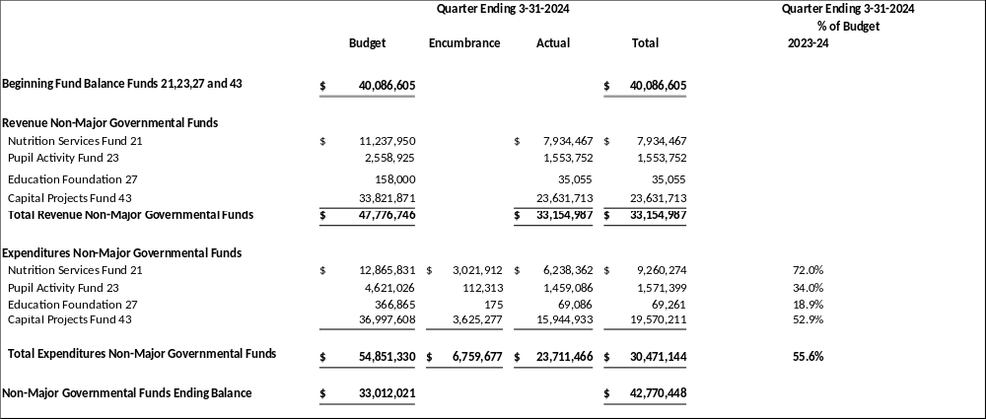
Non-Major Funds 21,23,27 and 43

Slide 11
Non-Major Funds 21 and 23
Non-Major Governmental Funds | Adopted Budget | Encumbrance | Actual | 3rd Quarter Total
Nutrition Services Fund 21
Beginning fund balance | $ 8,961,048 |  |  | $ 8,961,048
Revenue | $ 11,237,950 |  | $ 7,934,467 | $ 7,934,467
Expenditures | $ 12,865,831 | $ 3,021,912 | $ 6,238,362 | $ 9,260,274
Revenue over (under) expenditures | $ (1,627,881) | $ (3,021,912) | $ 1,696,105 | $ (1,325,807)
Ending fund balance | $ 7,333,167 | $ (3,021,912) | $ 1,696,105 | $ 7,635,241
Student Activities Fund 23
Beginning fund balance | $ 2,475,588 |  |  | $ 2,475,588
Revenue | $ 2,558,925 |  | $ 1,553,752 | $ 1,553,752
Expenditures | $ 4,621,026 | $ 112,313 | $ 1,459,086 | $ 1,571,399
Revenue over (under) expenditures | $ (2,062,101) | $ (112,313) | $ 94,667 | $ (17,646)
Ending fund balance | $ 413,487 | $ (112,313) | $ 94,667 | $ 2,457,942
Fund 21 Healthy School Meals for All
Fund 23 Fundraising continues

Slide 12
Non-Major Funds 27 and 43
Non-Major Governmental Funds | Adopted Budget | Encumbrance | Actual | 3rd Quarter Total
Education Foundation Fund 27
Beginning fund balance | $ 231,301 |  |  | $ 231,301
Revenue | $ 158,000 |  | $ 35,055 | $ 35,055
Expenditures | $ 366,865 | $ 175 | $ 69,086 | $ 69,261
Revenue over (under) expenditures | $ (208,865) | $ (175) | $ (34,030) | $ (34,205)
Ending fund balance | $ 22,436 | $ (175) | $ (34,030) | $ 197,096
Capital Projects Fund 43
Beginning fund balance | $ 28,418,668 |  |  | $ 28,418,668
Revenue | $ 33,821,871 |  | $ 23,631,713 | $ 23,631,713
Expenditures | $ 36,997,608 | $ 3,625,277 | $ 15,944,933 | $ 19,570,211
Revenue over (under) expenditures | $ (3,175,737) | $ (3,625,277) | $ 7,686,779 | $ 4,061,502
Ending fund balance | $ 25,242,931 | $ (3,625,277) | $ 7,686,779 | $ 32,480,170
Fund 27 Nothing to note
Fund 43 Best Grant Activity for CHPA will continue through summer. D60 HVAC Best Projects ending

Slide 13
QUESTIONS?

